Slide 1
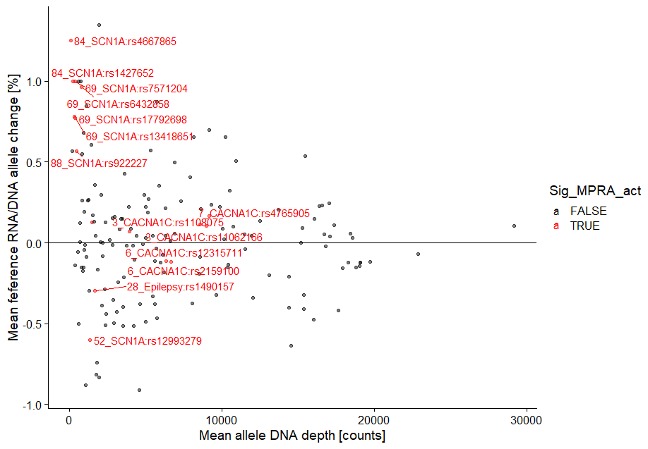
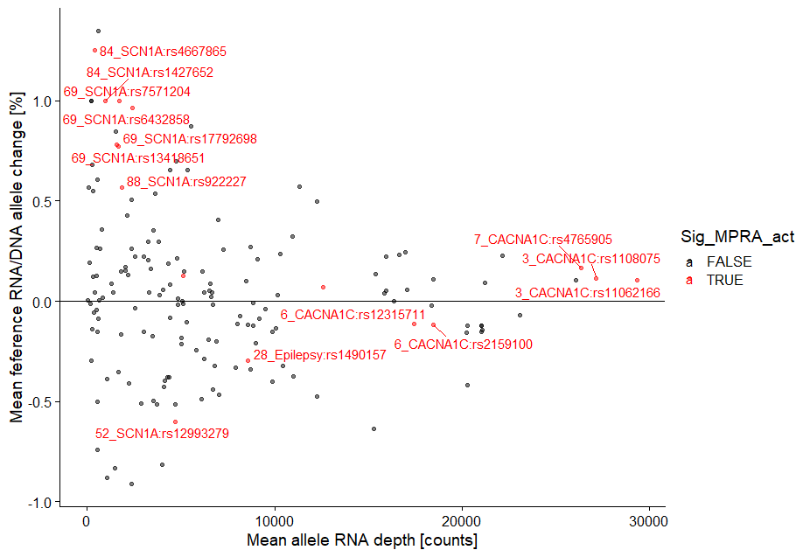

Slide 2
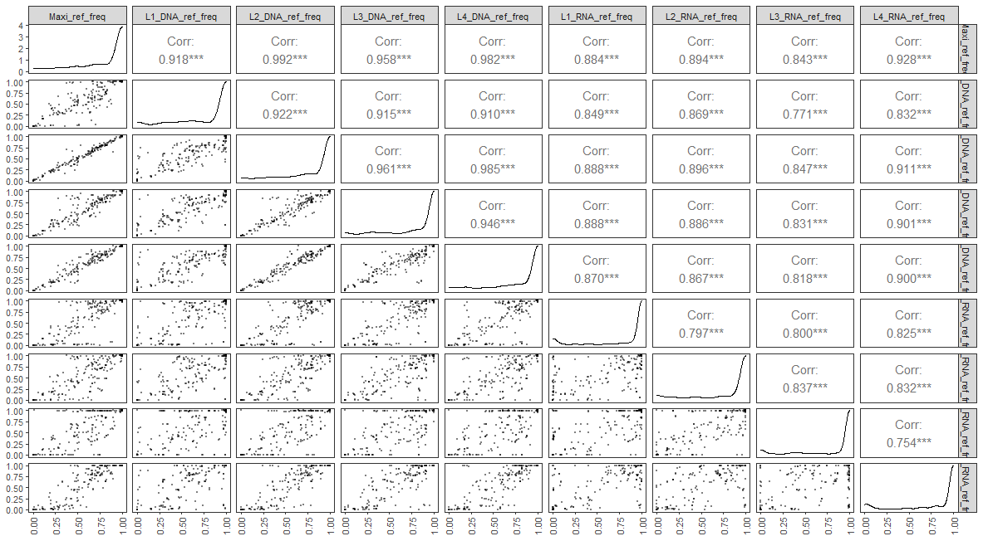
440 SNVs

Slide 3
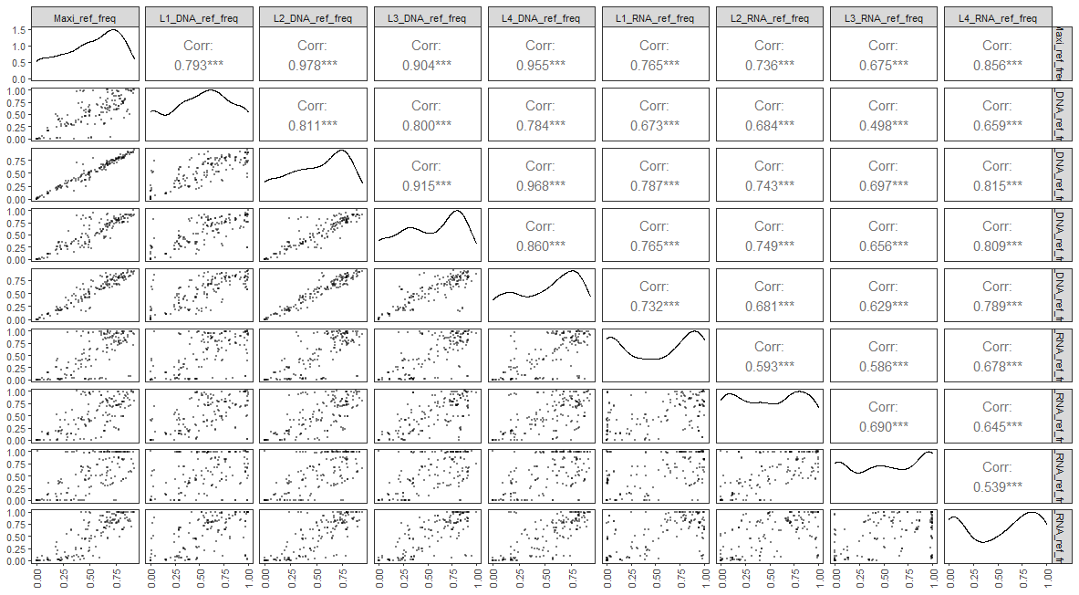
161 SNVs, after filtering alleles with ref allele freq > 0.95

Slide 4
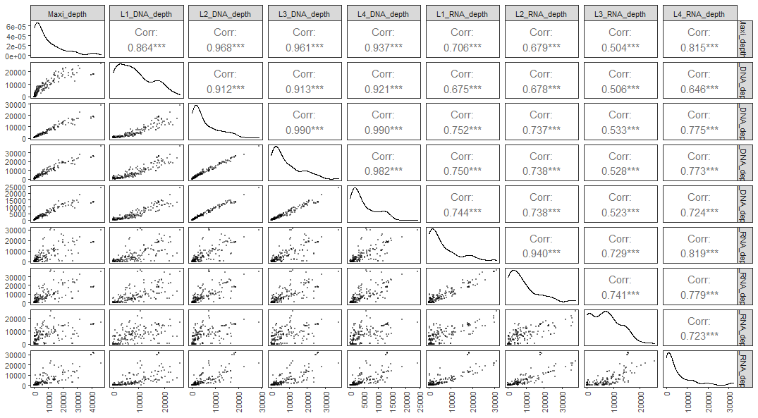
161 SNVs, after filtering alleles with ref allele freq > 0.95

Slide 5
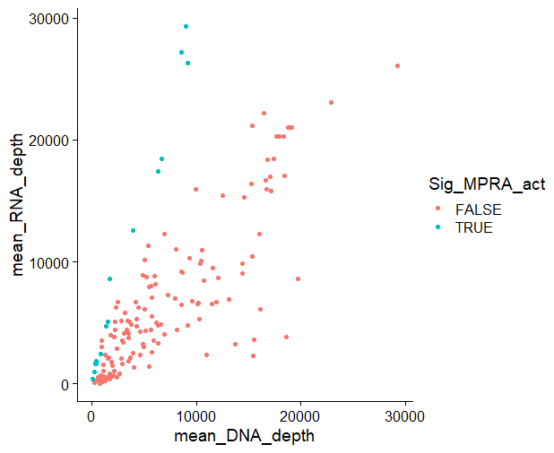
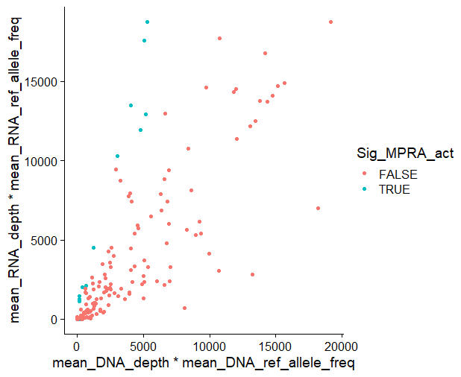

Slide 6
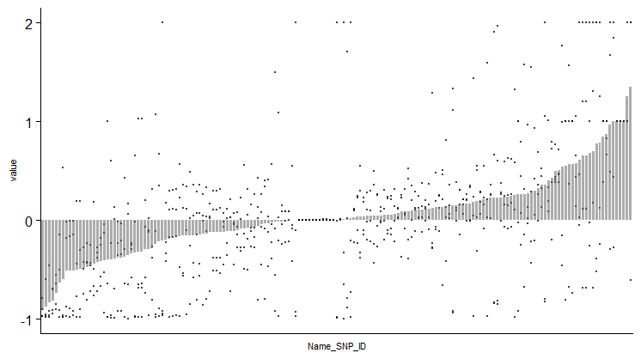
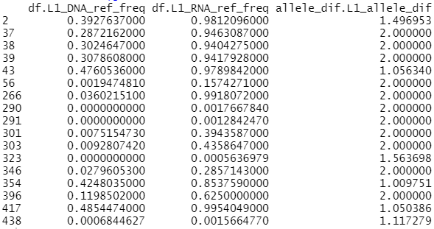

Slide 7
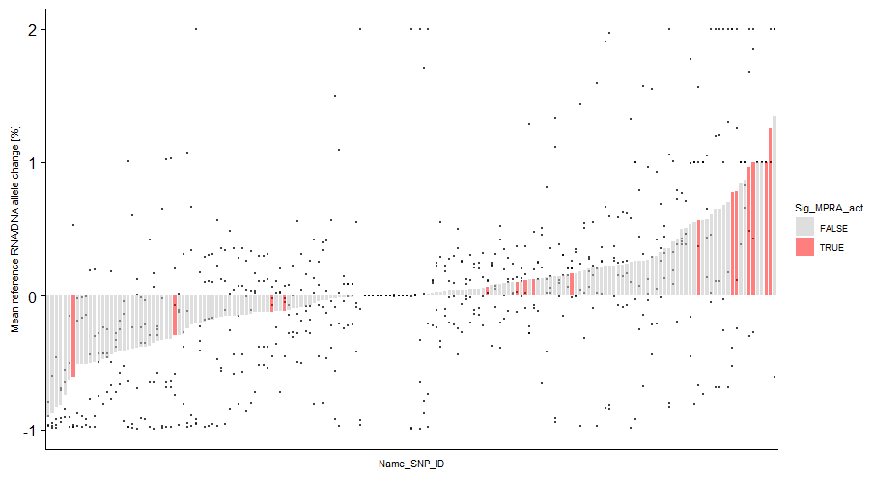
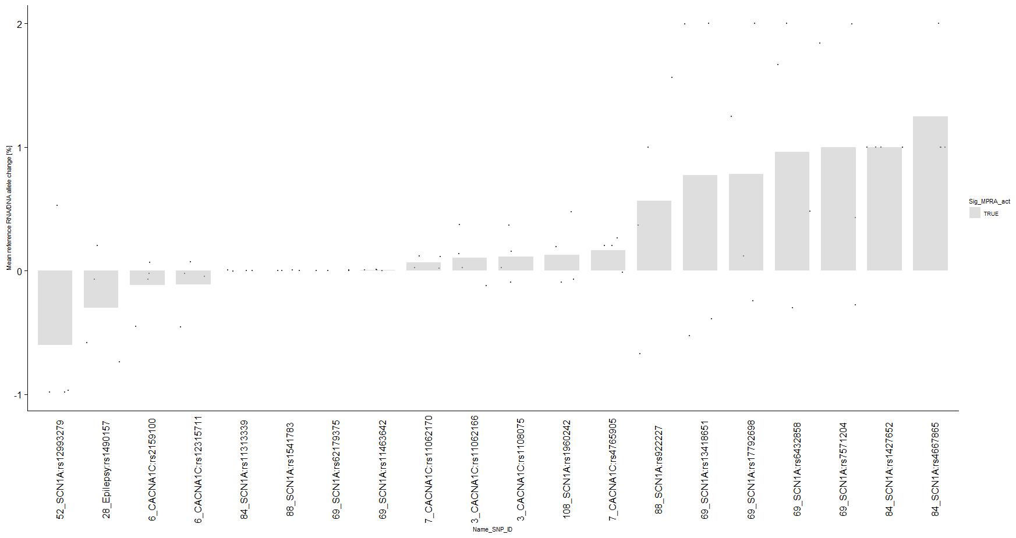

Slide 8
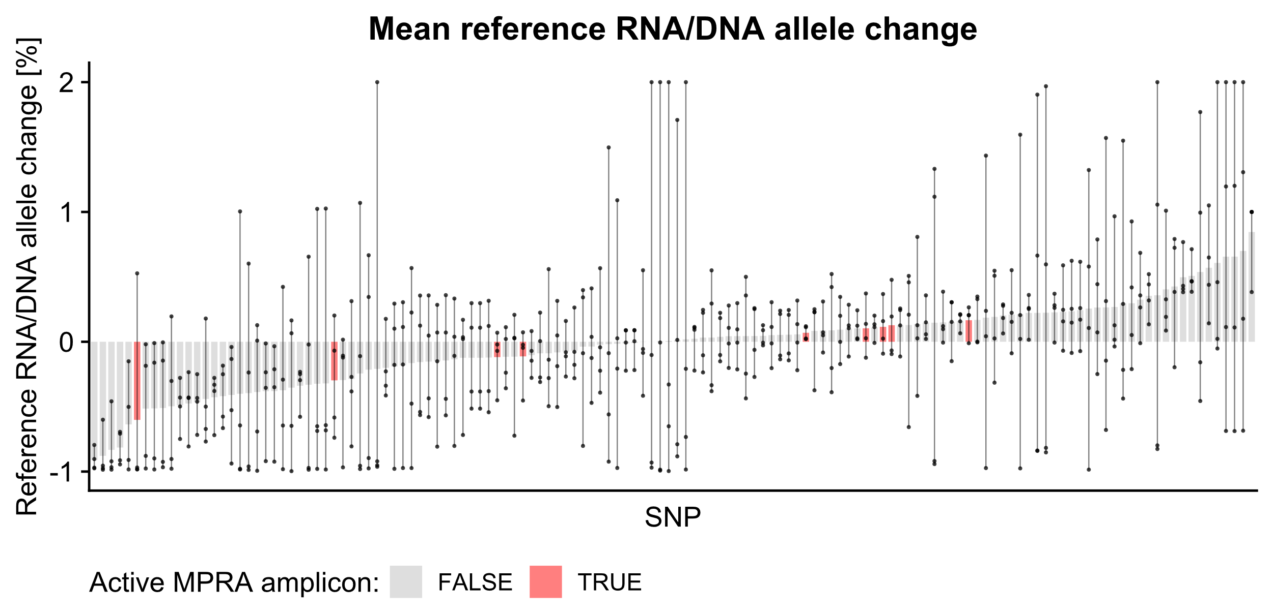
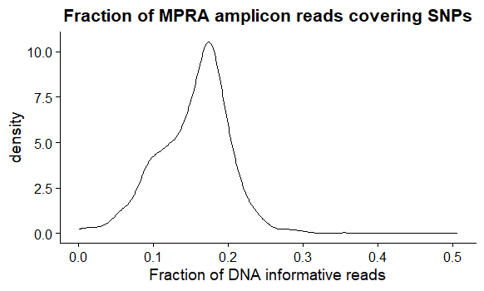
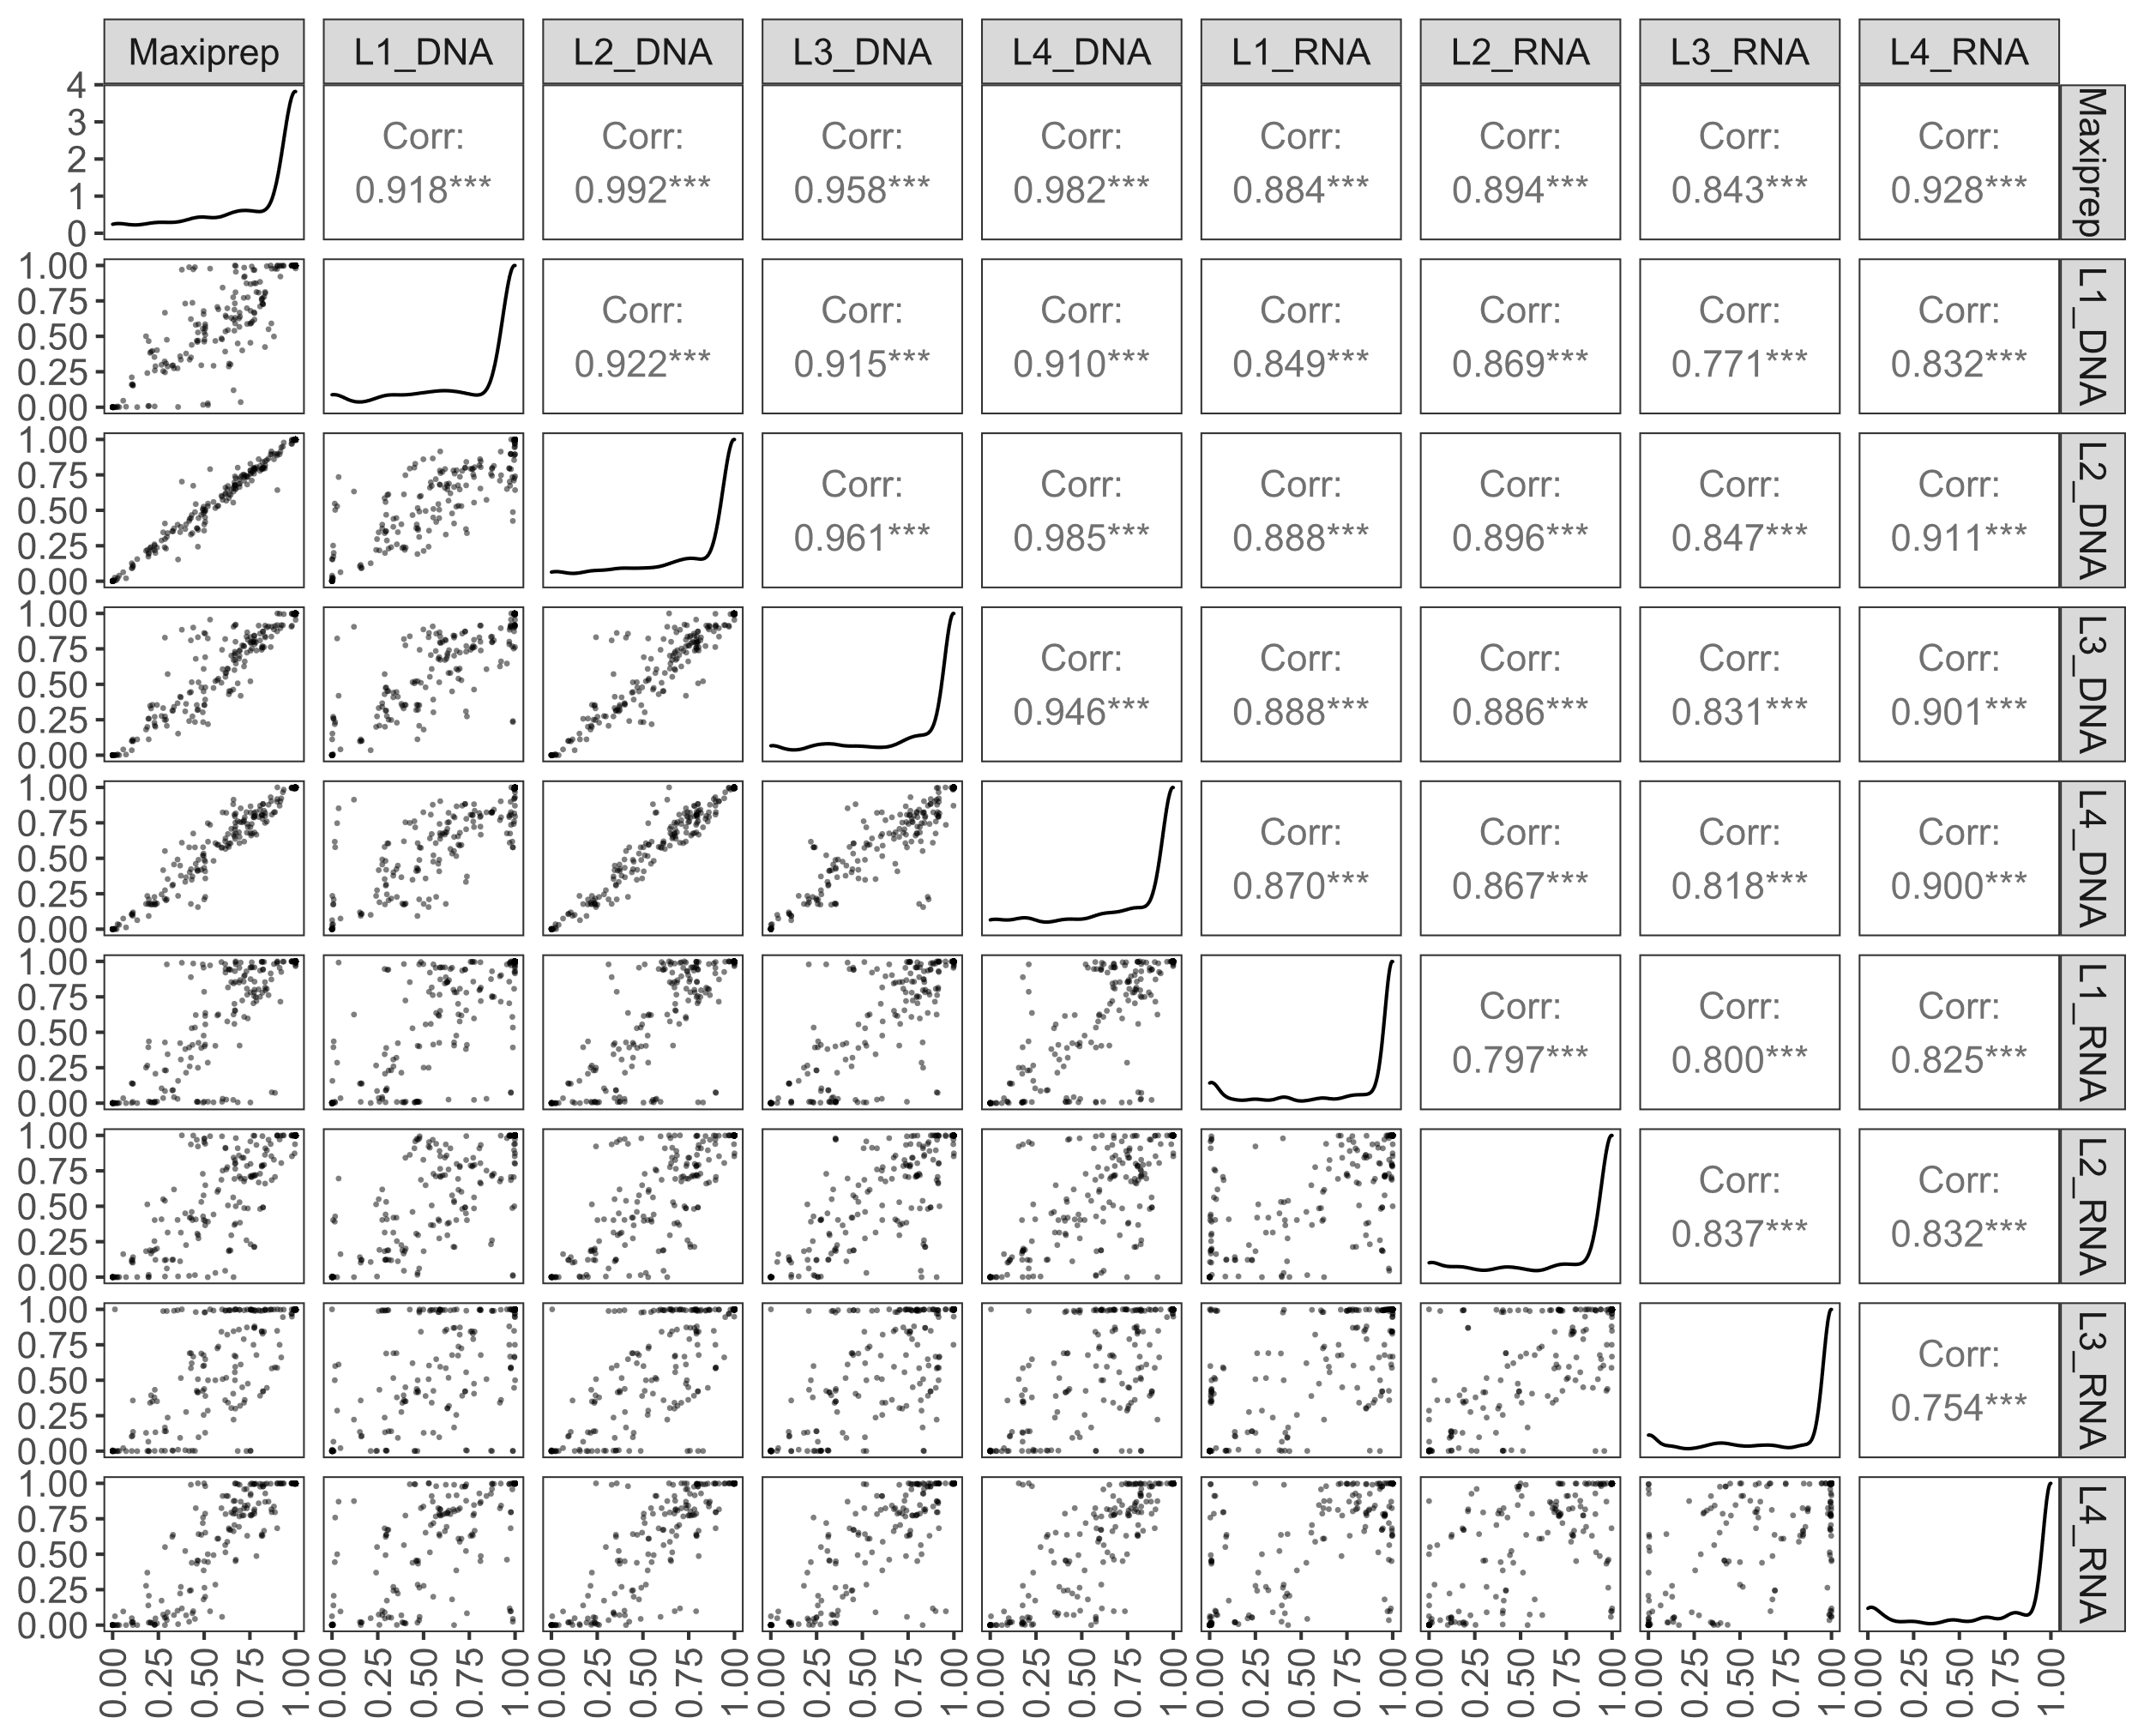
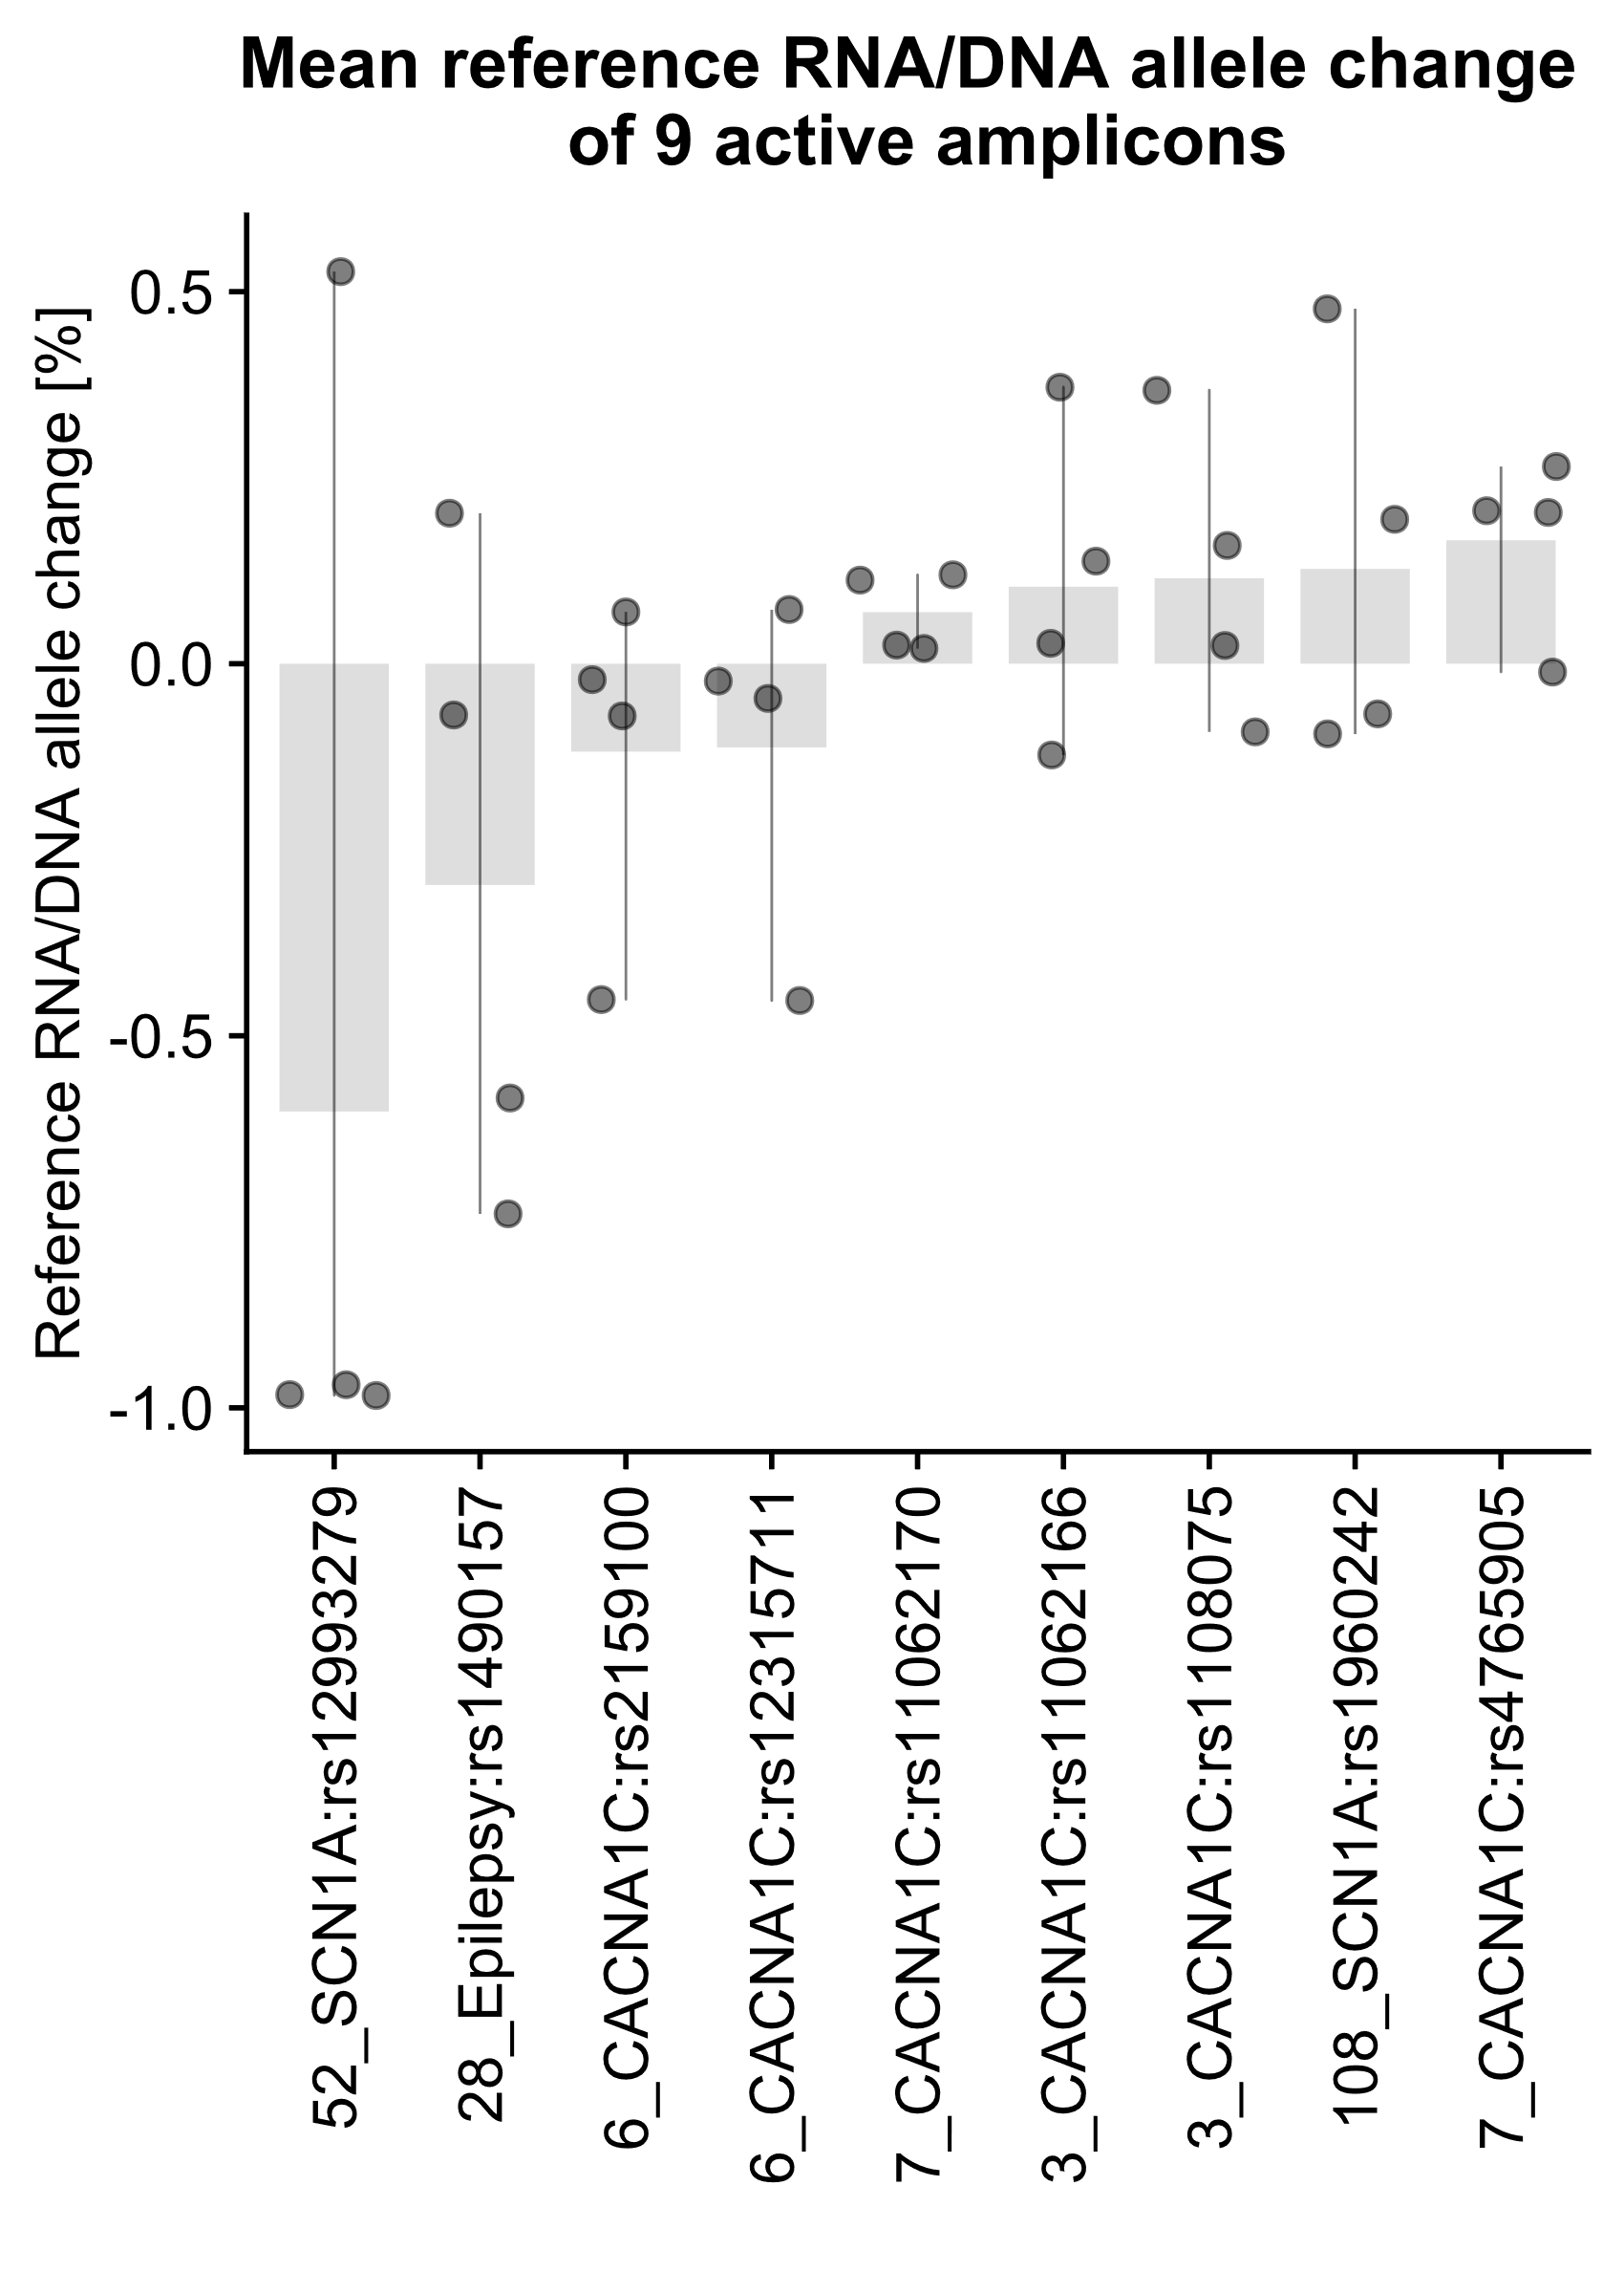
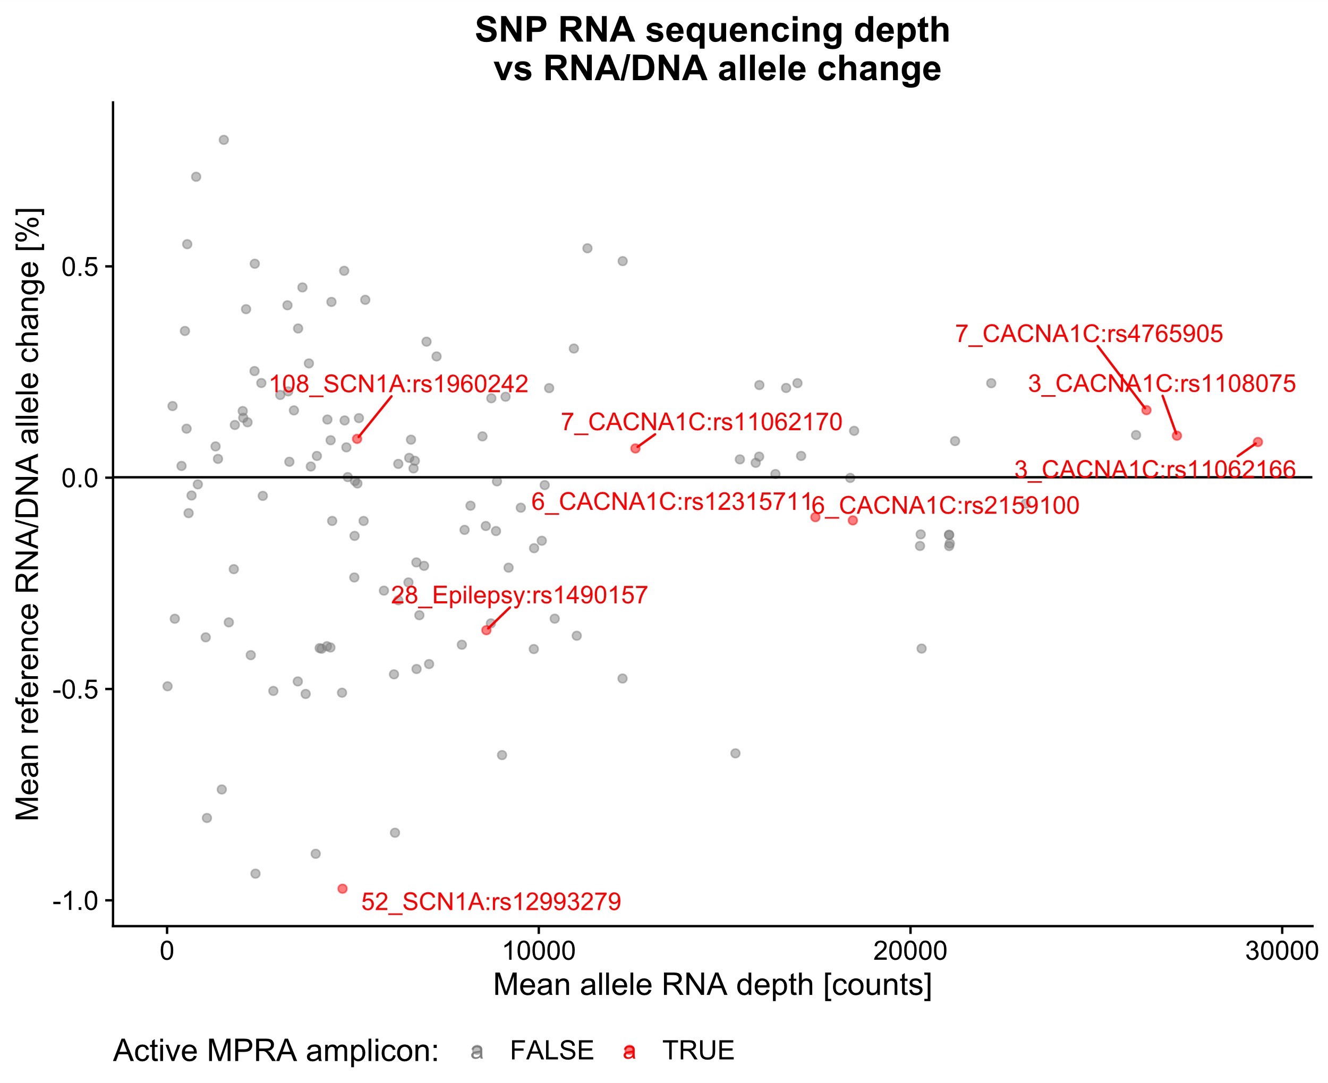
A
C
B
D
E
Notes:
Figure X – figure supplement Y. Statistics of the SNP calls in MPRA amplicons. (A) 440 SNPs detected in MPRA amplicons are covered by 15.4 % of reads mapping to 314 MPRA amplicons, an expected proportion considering ~900 bp MPRA amplicon reads, 100 bp sequencing reads, and the library preparation protocol. Calculated for 4 DNA MPRA libraries; (B) Allele capture is reproducible… Reference allele frequency correlations and density plots of the pre-viral maxiprep, DNA, and RNA MPRA libraries reveal that the majority of alleles have reference allele frequency close to 1. DNA allele frequency is more consistent than RNA allele frequency. (C)

Slide 9
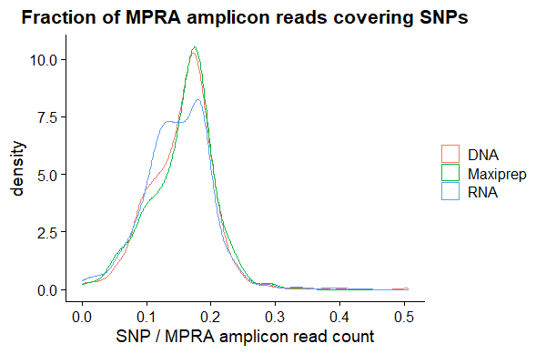
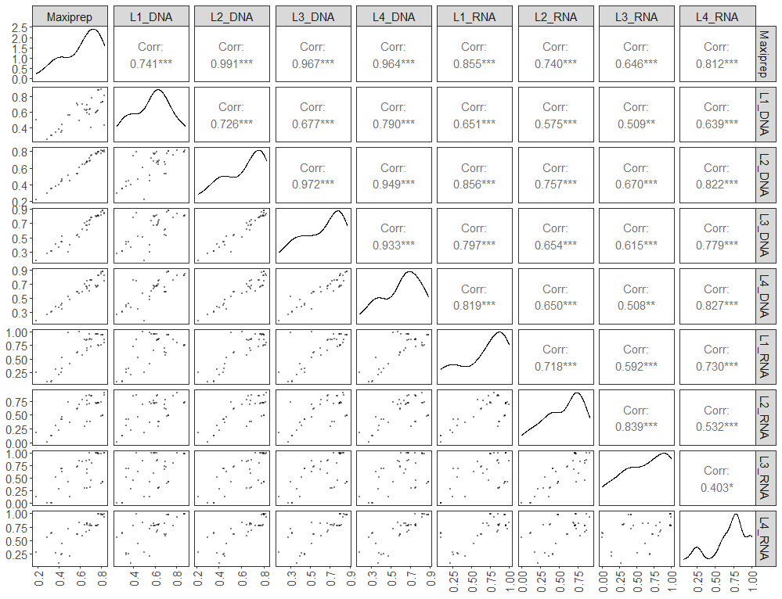
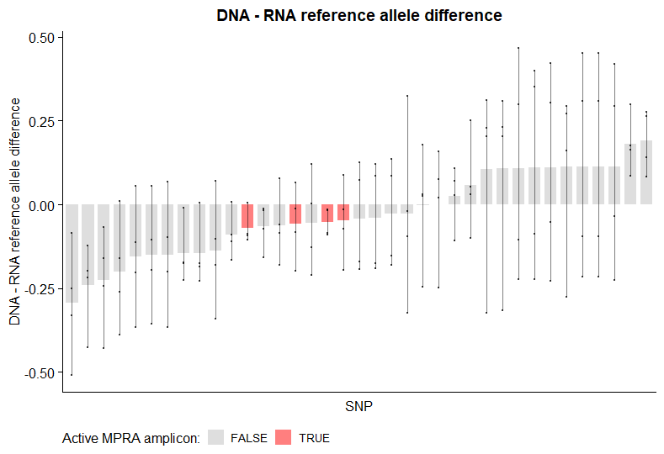

Slide 10
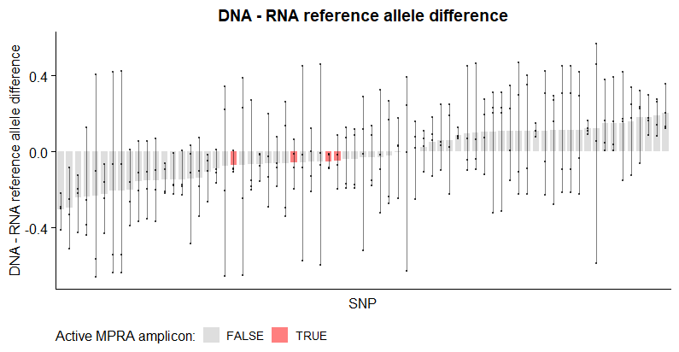
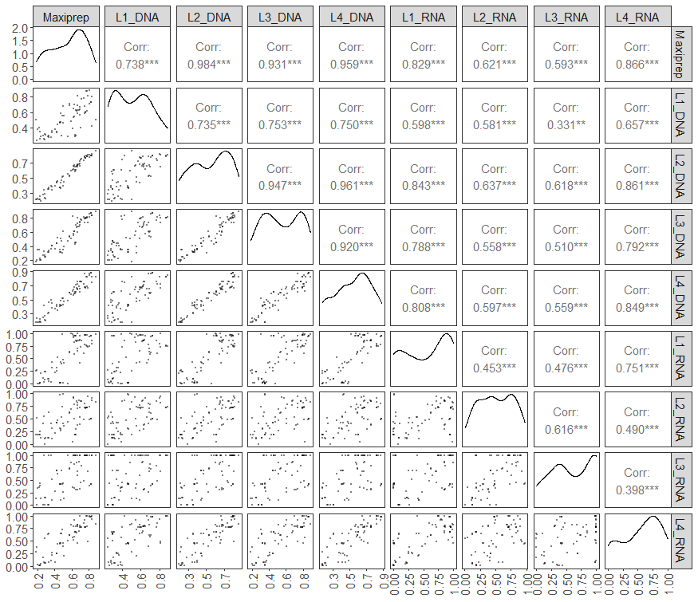

Slide 11
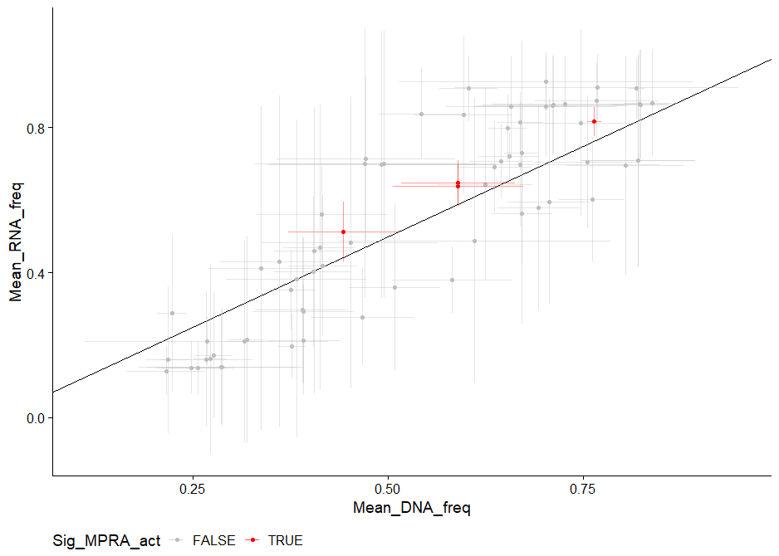
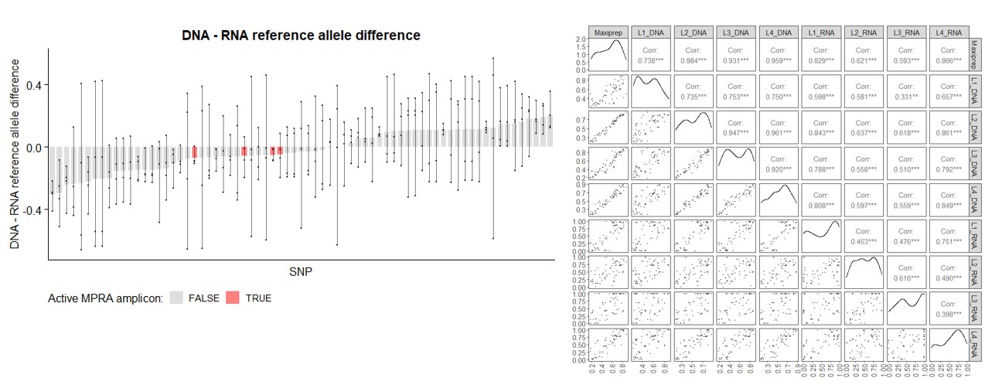
Notes:
Equal axis scaling.. Select amplicons above median act score, from the 37.
Appreciate the interest. We left out because these experiments lack power to resolve allelic differences. 1) Delivery in vivo resulted in issue with increased complexity.
Good correlation among DNA samples, lower concordance among RNA, but enough noise to preclude comparisons. This assay needs to be refined. We did not observe differences in Hek293 cells – luciferase.
Panels: Split DNA and RNA into two correlation matrix. Add Maxiprep as an anchor in both. Add the 35 sample to demonstrate lack of PCR bias.
Threshold on 0.95 and 0.05 DNA freq threshold. Allele informative reads.

Slide 12
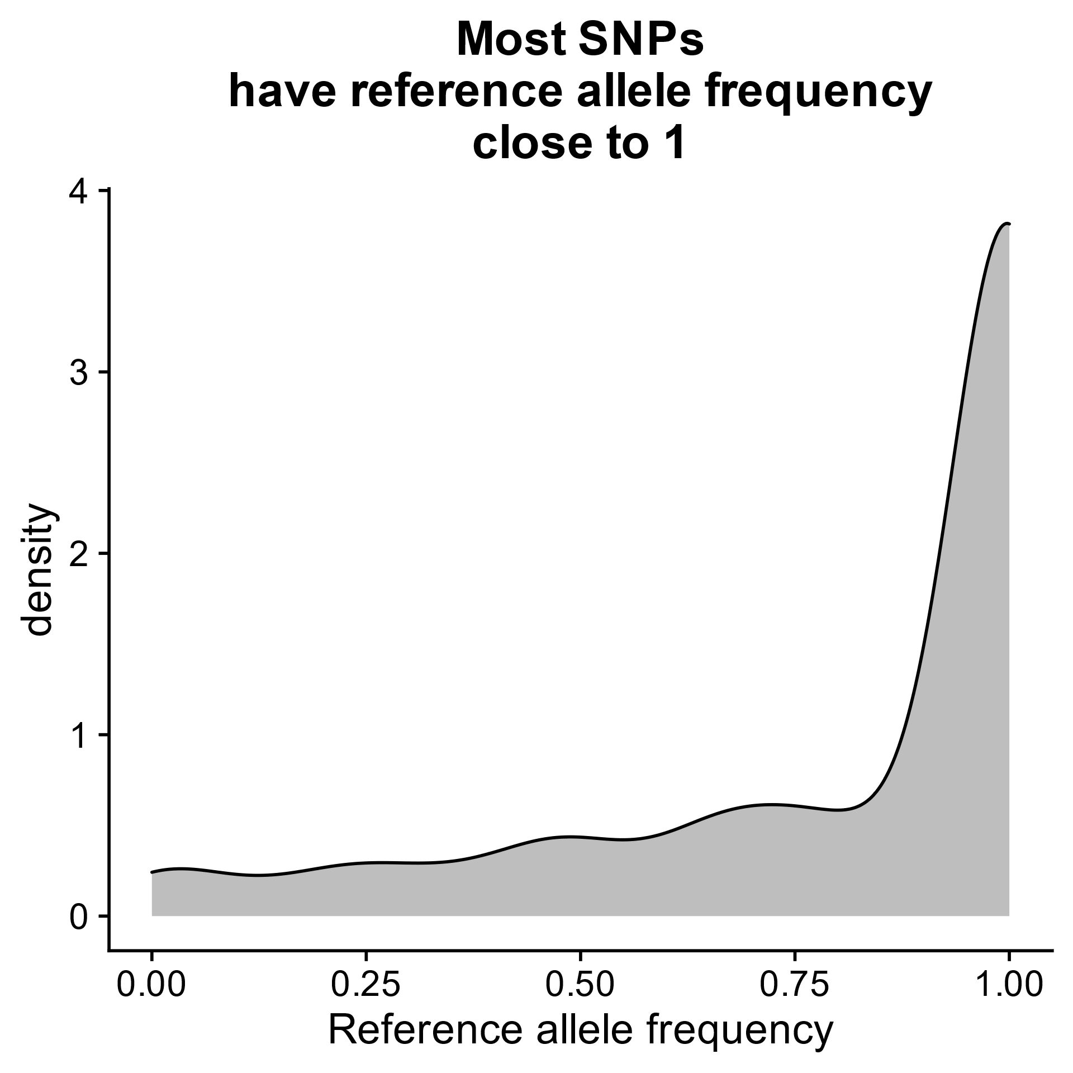
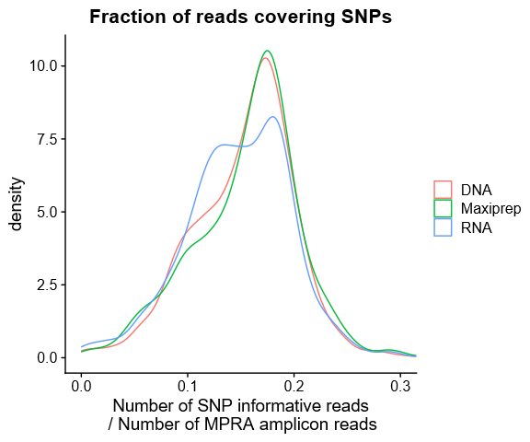
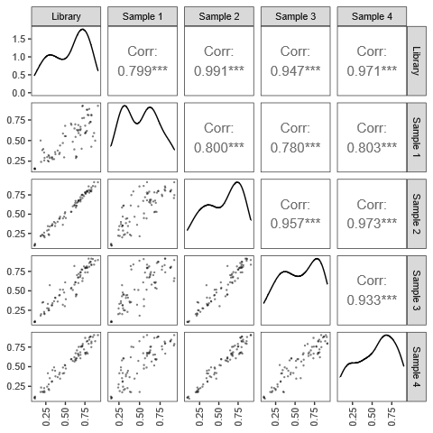
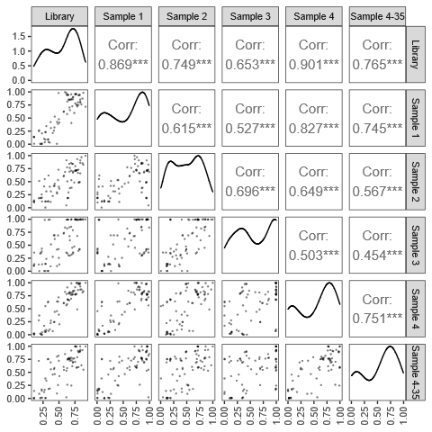
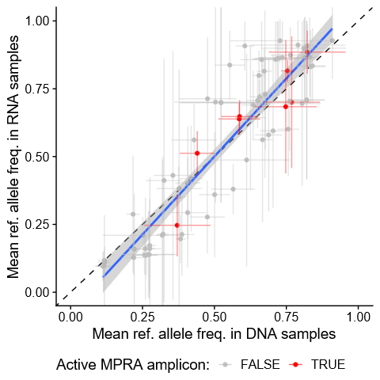
A
B
C
Schematic of STARRseq tagmentation capturing alleles
D
E
F
Notes:
Supplementary figure X. (A) 440 Maxiprep SNPs. (B) Jason; (C) all 400 SNPs; (D) Ref allele freq in DNA. 77 amplicons passing DNA, RNA and freq thresholds. All withing the 308 amplicon set. (E) Ref allele freq in RNA. 77 amplicons passing DNA, RNA and freq thresholds. All withing the 308 amplicon set.

